Slide 1

Random Chat
Application
Prajwal Sharma (19BCS1144)
CSE 1-C

Slide 2

CONTENT :
Introduction & History
About This Project
Benefits & Work Area
Structure
Working
What we learned

Slide 3
INTRODUCTION & HISTORY
• Instant messaging (IM) technology is a type of online chat allowing real-time text transmission over the Internet or another computer network. Messages are typically transmitted between two or more parties, when each user inputs text and triggers a transmission to the recipient(s), who are all connected on a common network. It differs from email in that conversations over instant messaging happen in real-time (hence "instant"). Most modern IM applications (sometimes called "social messengers", "messaging apps" or "chat apps") use push technology and also add other features such as emojis (or graphical smileys), file transfer, chatbots, Voice over IP, or video chat capabilities.
• Instant messaging systems tend to facilitate connections between specified known users (often using a contact list also known as a "buddy list" or "friend list"), and can be standalone applications or integrated into e.g. a wider social media platform, or a website where it can for instance be used for conversational commerce. IM can also consist of conversations in "chat rooms". Depending on the IM protocol, the technical architecture can be peer-to-peer (direct point-to-point transmission) or client–server (an IM service center retransmits messages from the sender to the communication device). It is usually distinguished from text messaging which is typically simpler and normally uses cellular phone networks.

Slide 4
INTRODUCTION & HISTORY
• Instant messaging was pioneered in the early Internet era; the IRC protocol was the earliest to achieve wide adoption. Later in the 1990s, ICQ was among the first closed and commercialized instant messengers, and several rival services appeared afterwards as it became a popular use of the Internet. Beginning with its first introduction in 2005, BlackBerry Messenger, which initially had been available only on BlackBerry smartphones, soon became one of the most popular mobile instant messaging apps worldwide. BBM was for instance the most used mobile messaging app in the United Kingdom and Indonesia. Instant messaging remains very popular today; IM apps are the most widely used smartphone apps: in 2018 there were over 1.3 billion monthly users of WhatsApp and Facebook Messenger, and 980 million monthly active users of WeChat.
• Instant messaging is a set of communication technologies used for text-based communication between two (private messaging) or more (chatroom) participants over the Internet or other types of networks (see also LAN messenger). IM–chat happens in real-time. Of importance is that online chat and instant messaging differ from other technologies such as email due to the perceived quasi-synchrony of the communications by the users. Some systems permit messages to be sent to users not then 'logged on' (offline messages), thus removing some differences between IM and email (often done by sending the message to the associated email account).

Slide 5
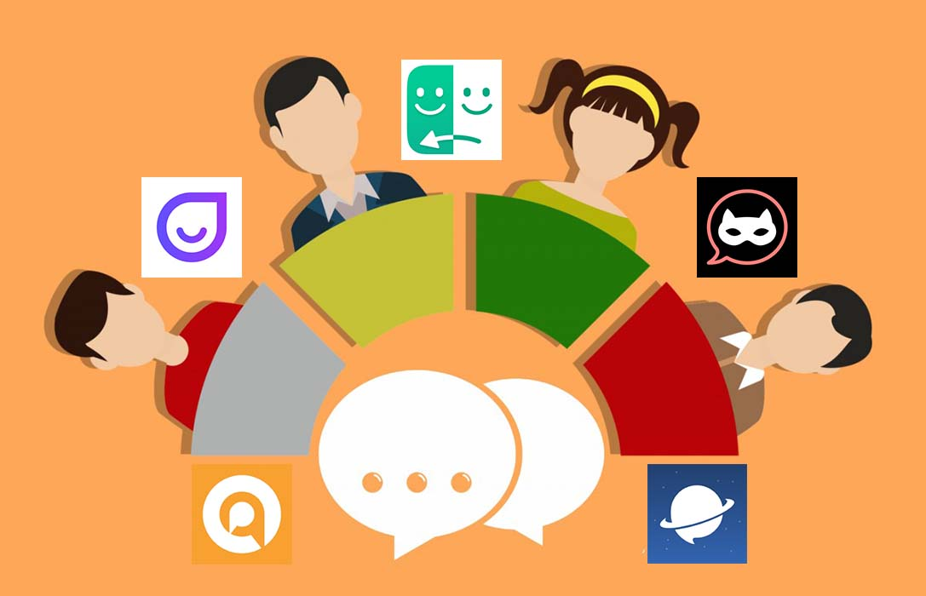
ABOUT THIS PROJECT
DEFINITION : A chat room is a Web site, part of a Web site, or part of an online service such as America Online, that provides a venue for communities of users with a common interest to communicate in real time.
• Random Chat Application is a type of web application in which user can talk to random people with anonymous name.

Slide 6

BENEFITS & WORK AREA
=> You are anonymous when you are chatting with random people.
WORK AREAS :
Chance to meet new people with different views.
The opportunity to get perspectives from around the world.
Easy to find people based on your age, gender identity, sexual orientation, interests, and goals (whether you're looking for social support or dating).

Slide 7
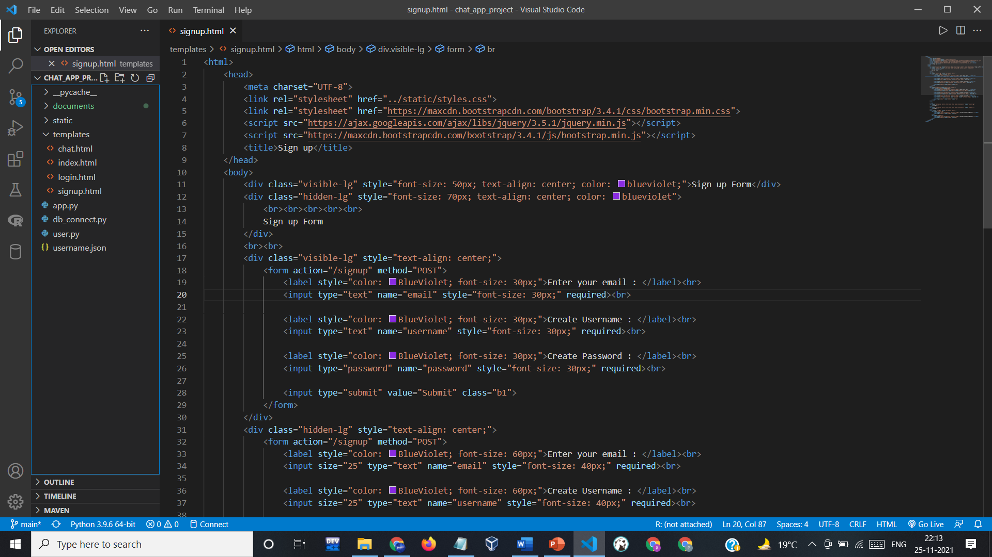
STRUCTURE =>
1. SIGNUP PAGE :

Slide 8
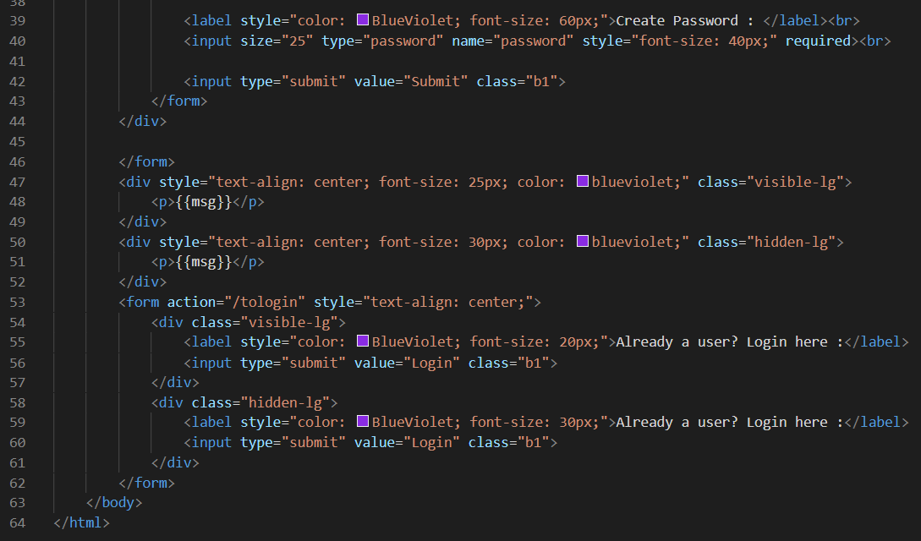
STRUCTURE =>
1. SIGNUP PAGE :

Slide 9
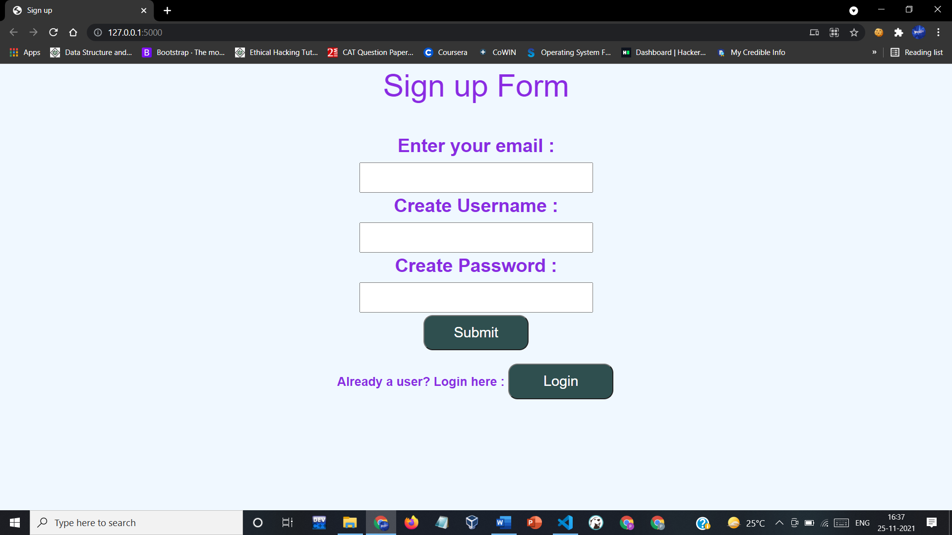
STRUCTURE
1. SIGNUP PAGE :

Slide 10

2. LOGIN PAGE :

Slide 11
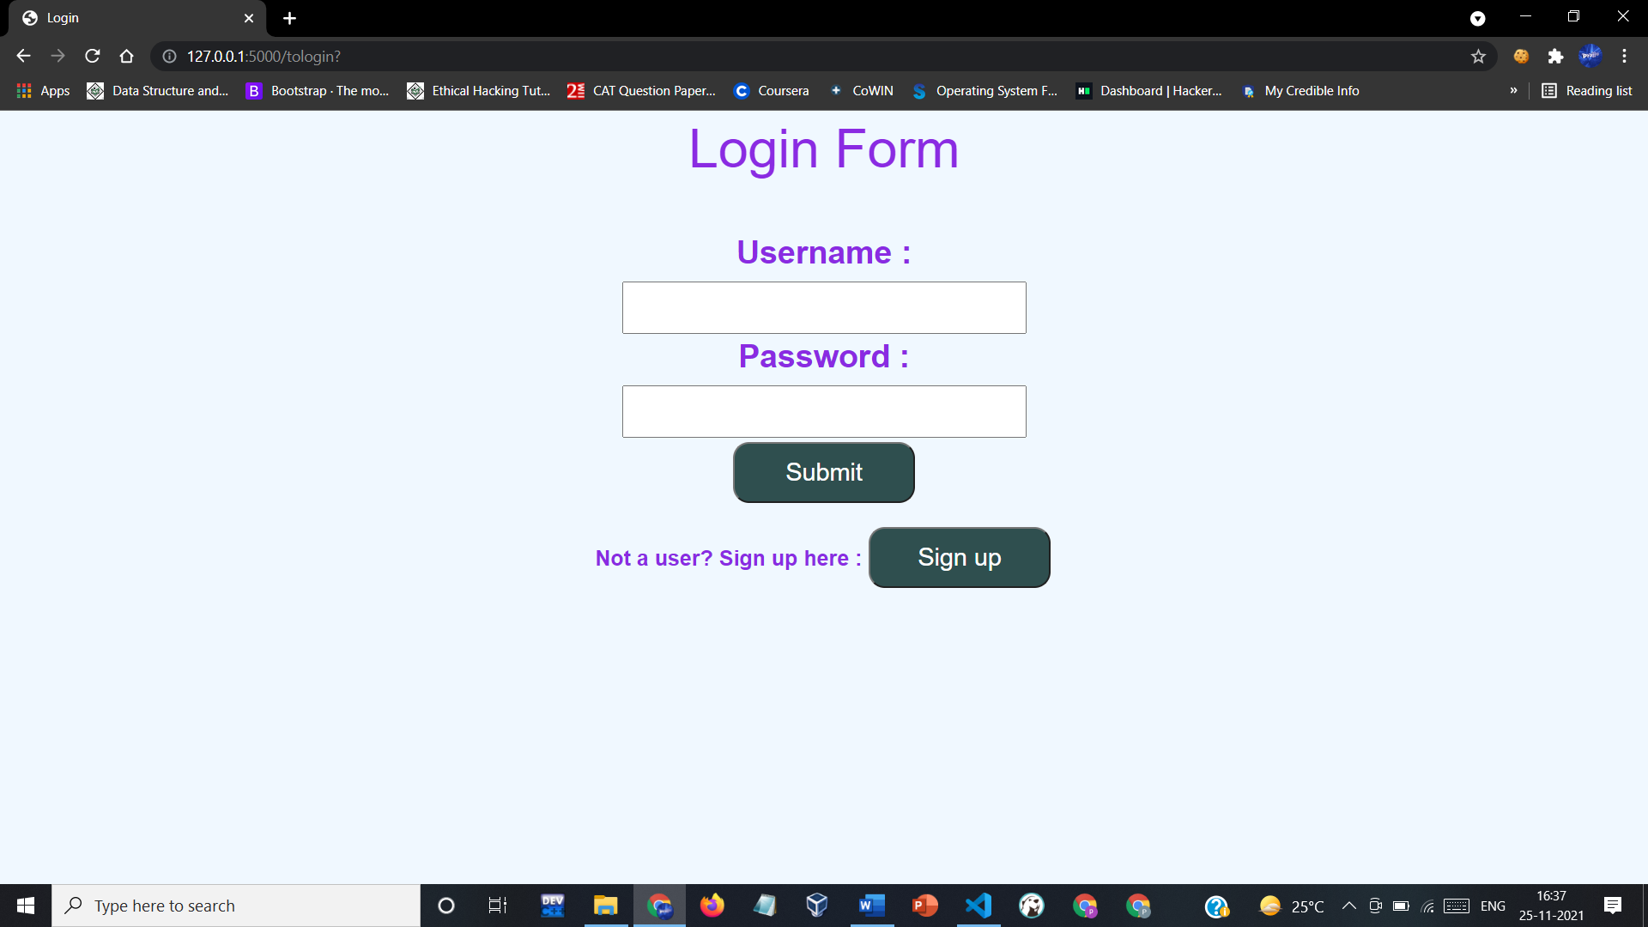
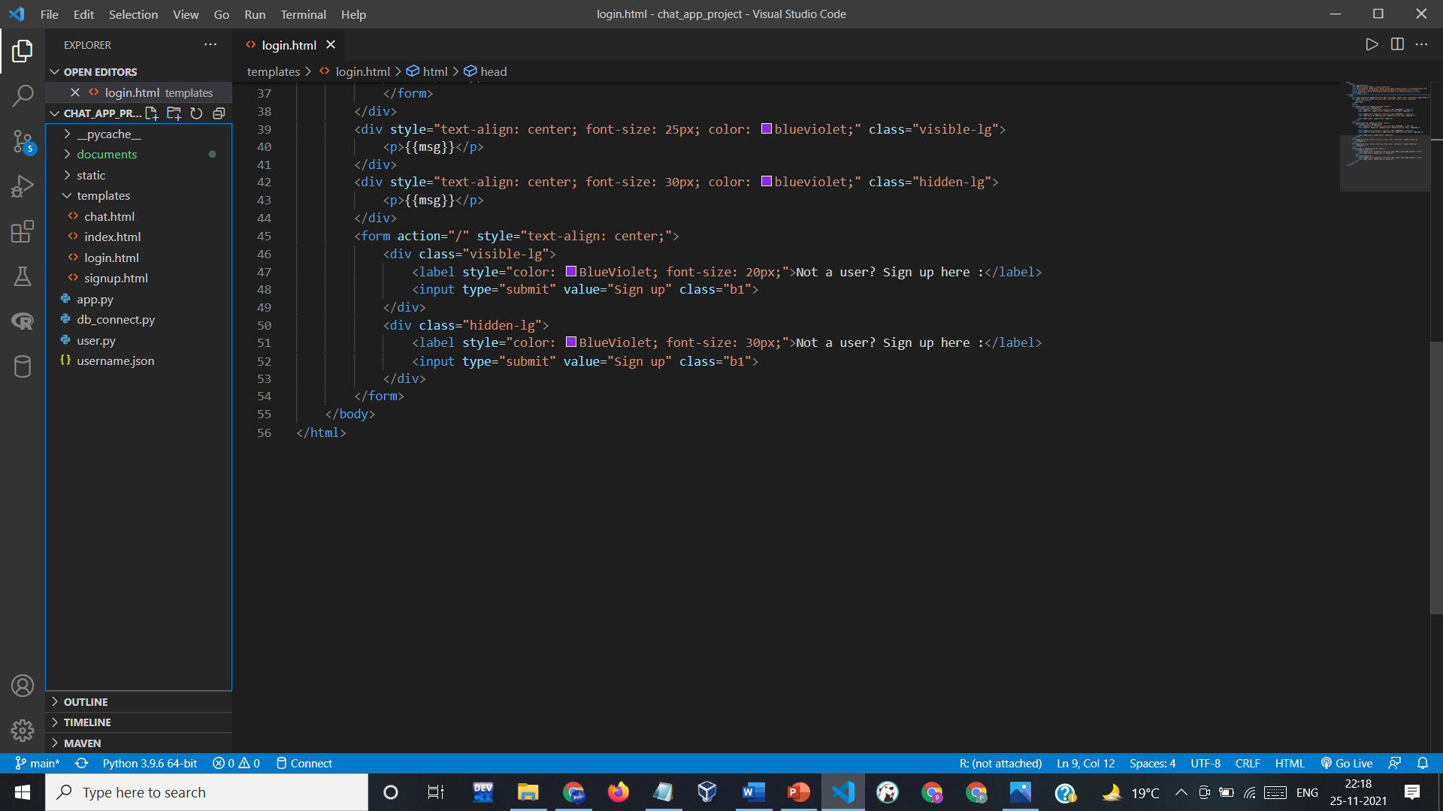
2. LOGIN PAGE :

Slide 12
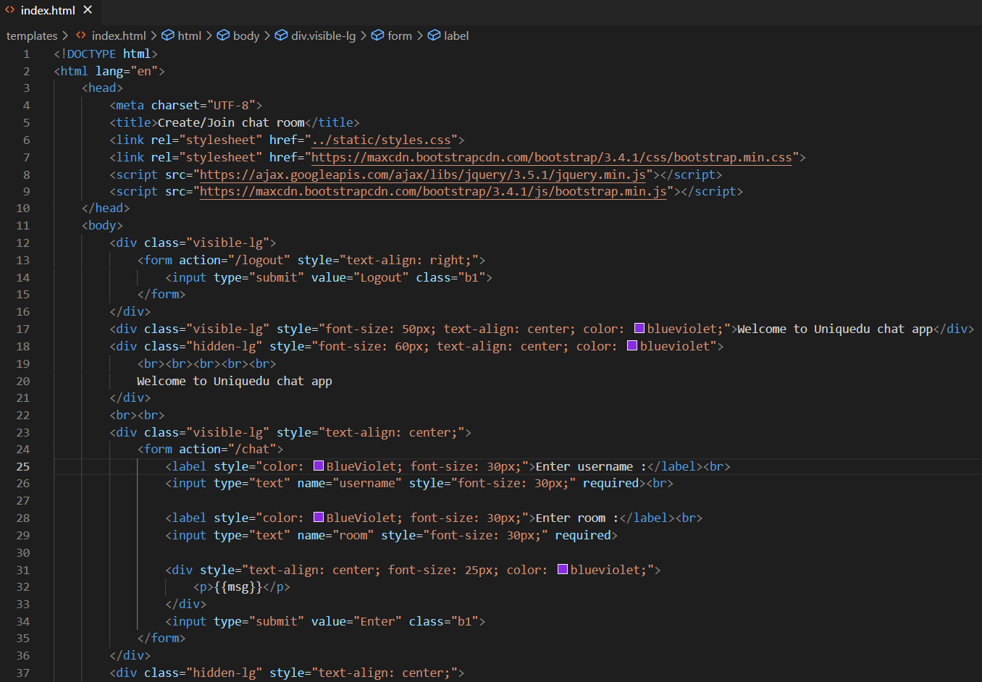
3. ROOM JOINING/CREATING PAGE :

Slide 13
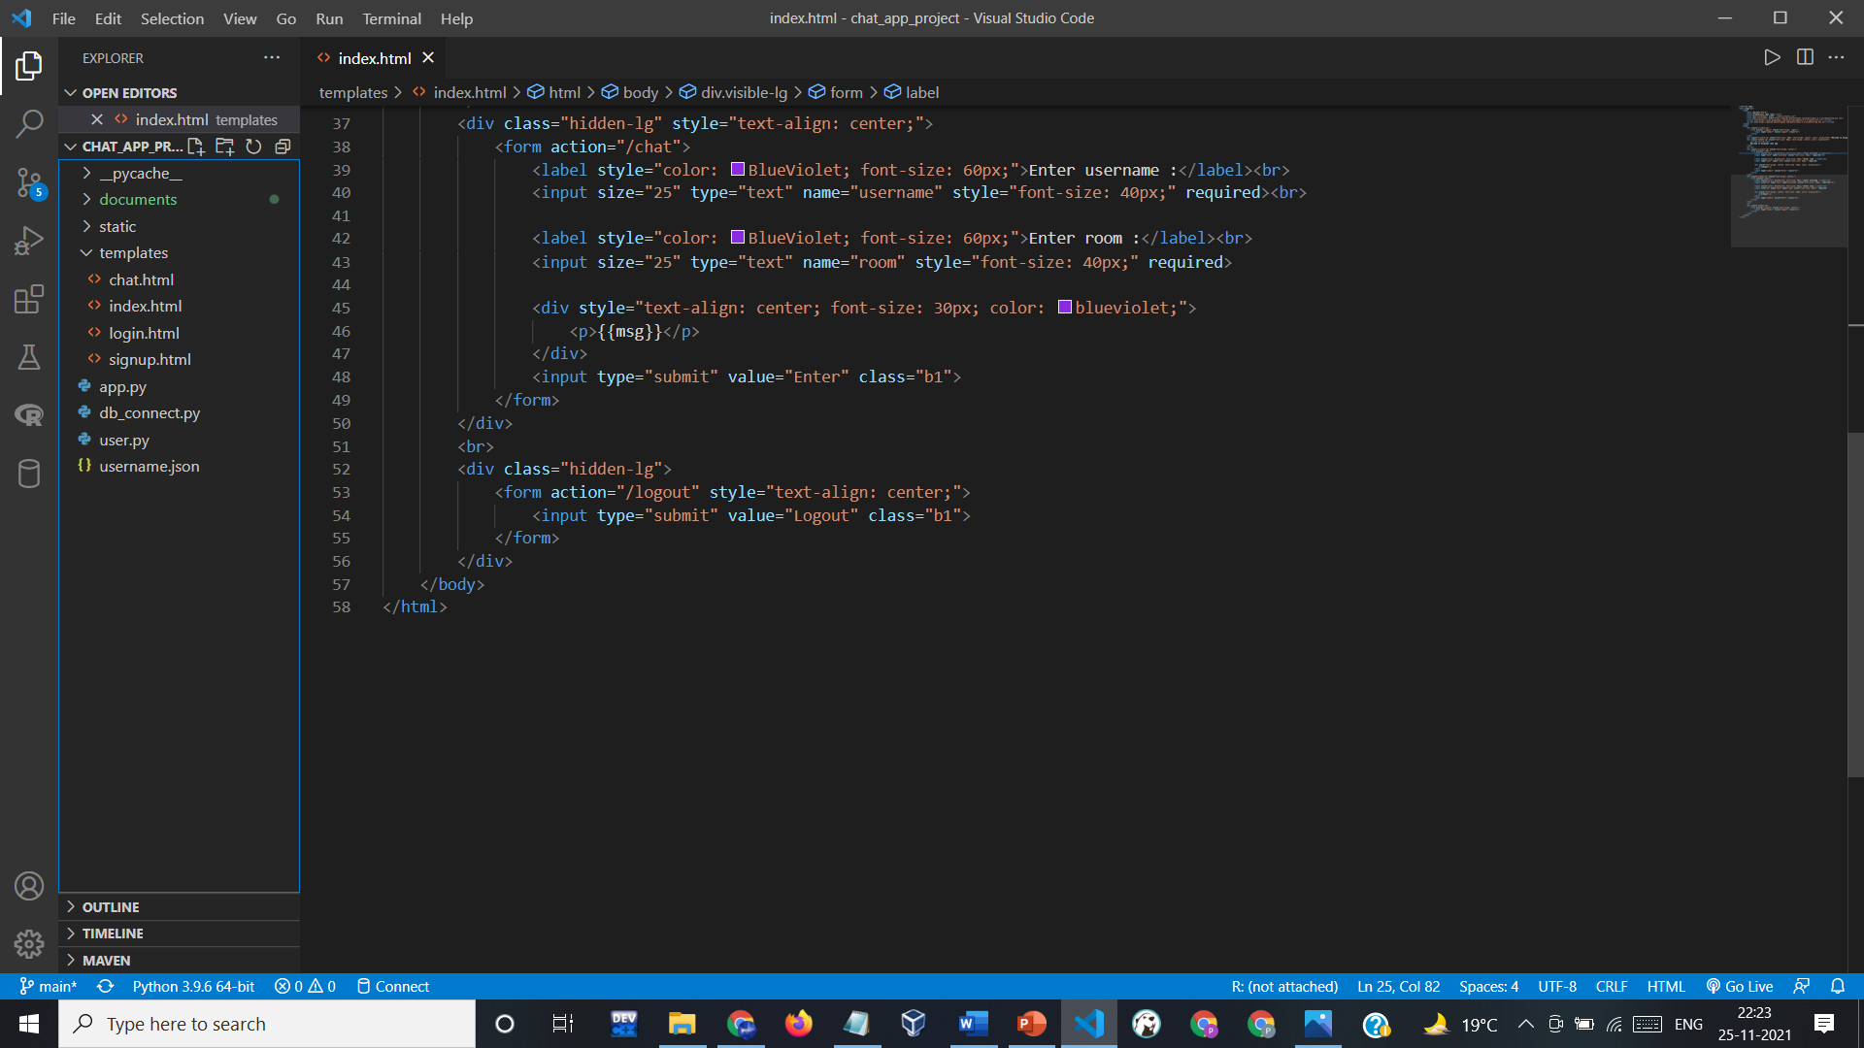
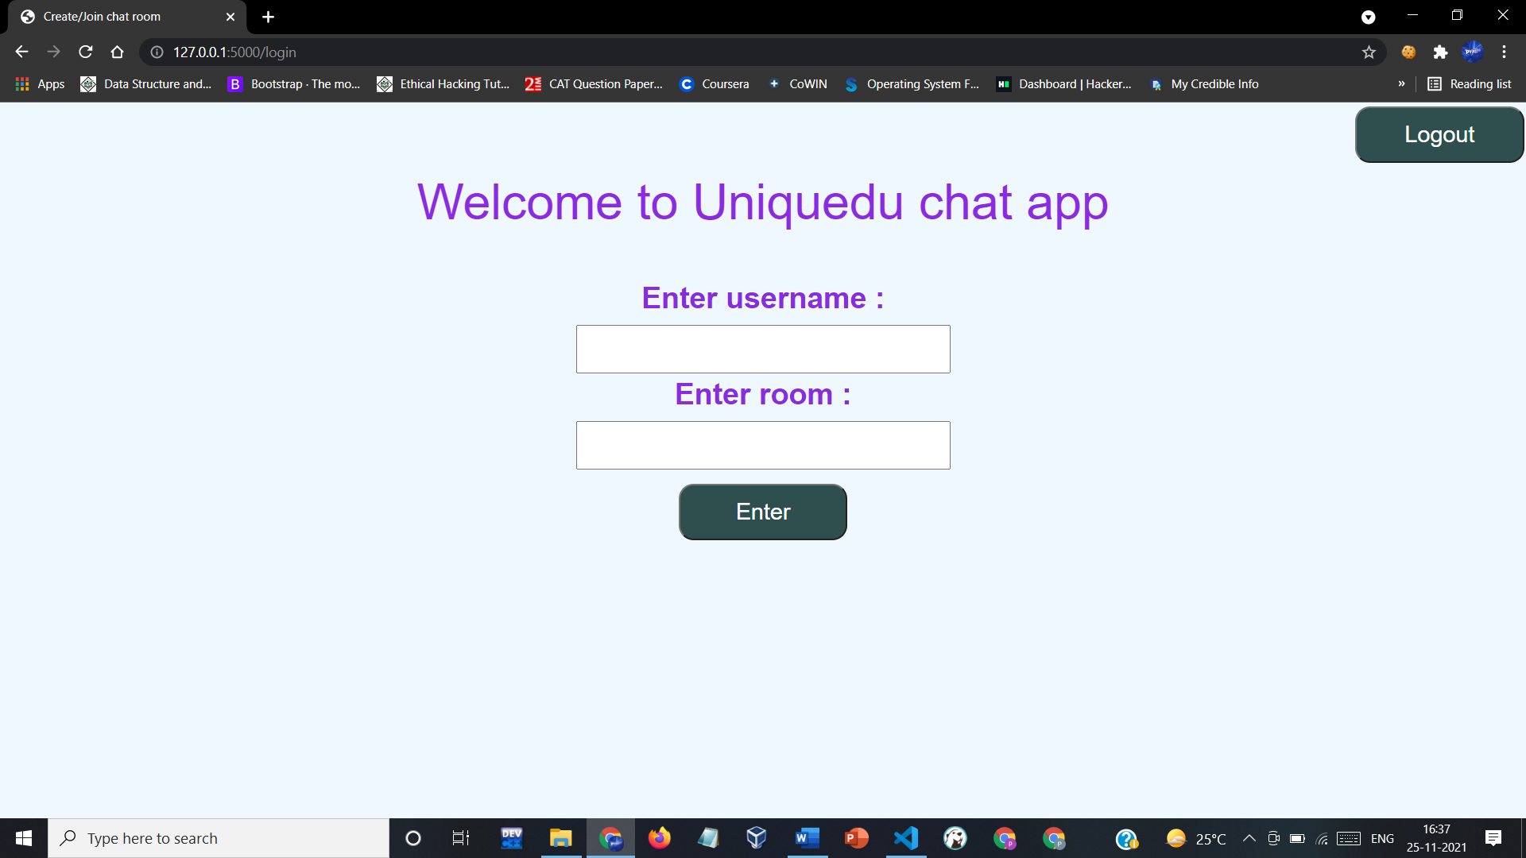
3. ROOM JOINING/CREATING PAGE :

Slide 14

4. MESSAGING PAGE :

Slide 15
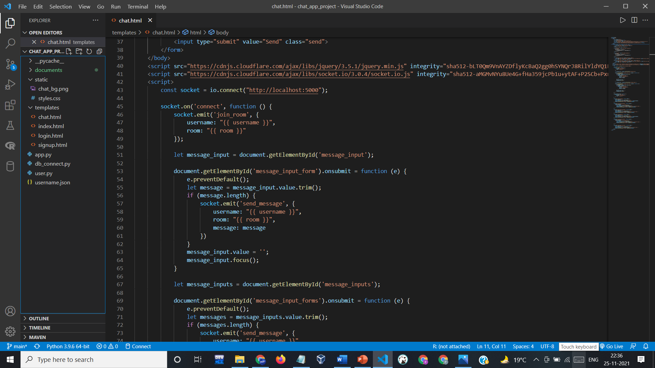
4. MESSAGING PAGE :

Slide 16
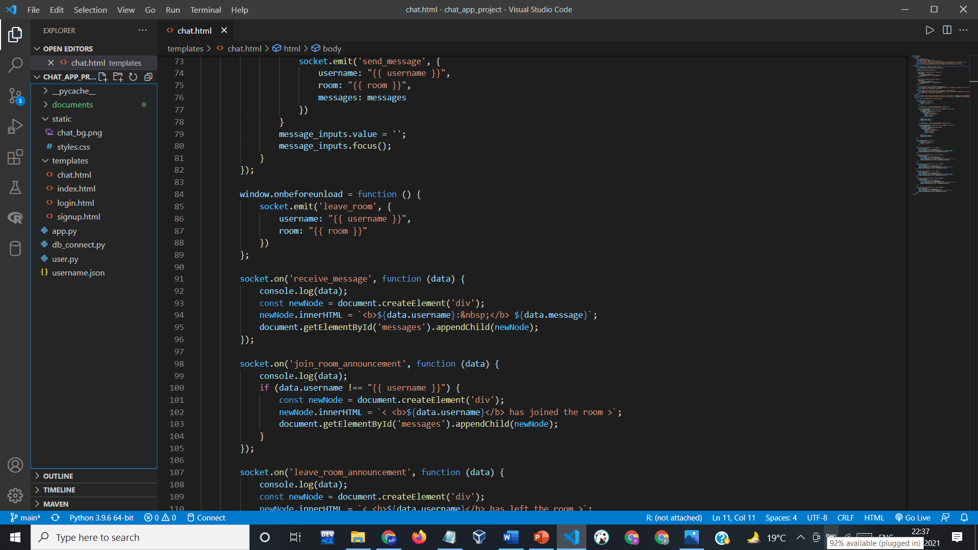
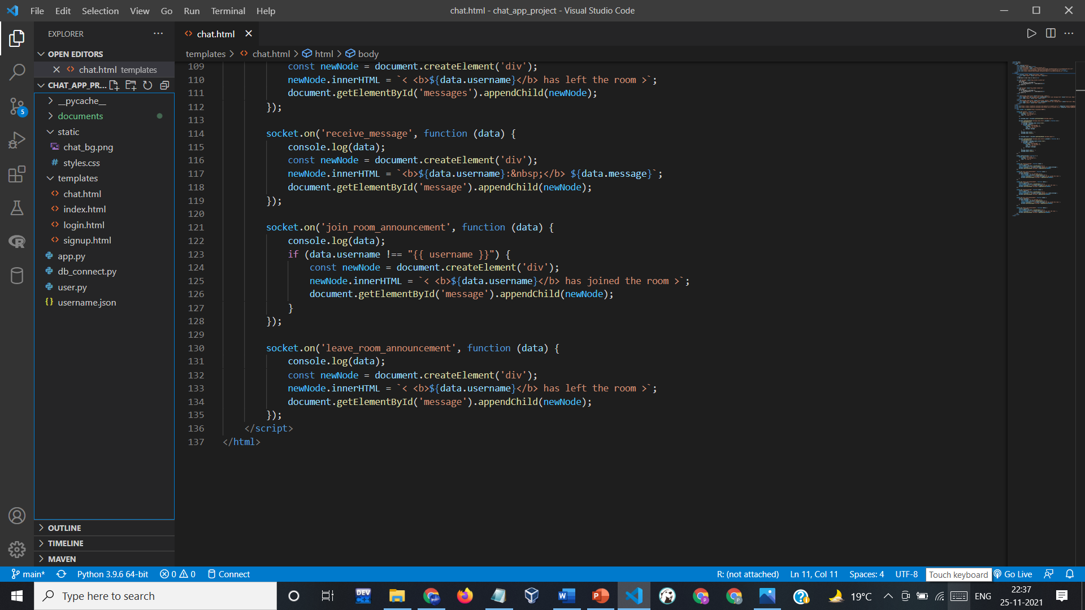
4. MESSAGING PAGE :

Slide 17
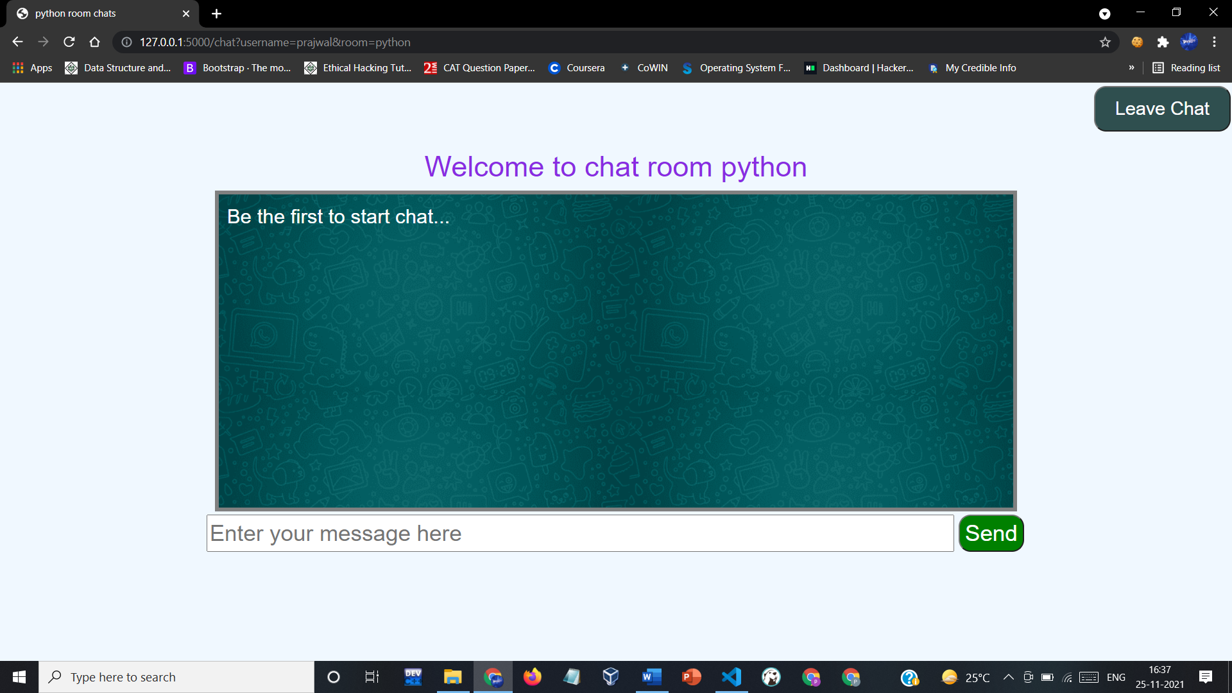
4. MESSAGING PAGE :

Slide 18
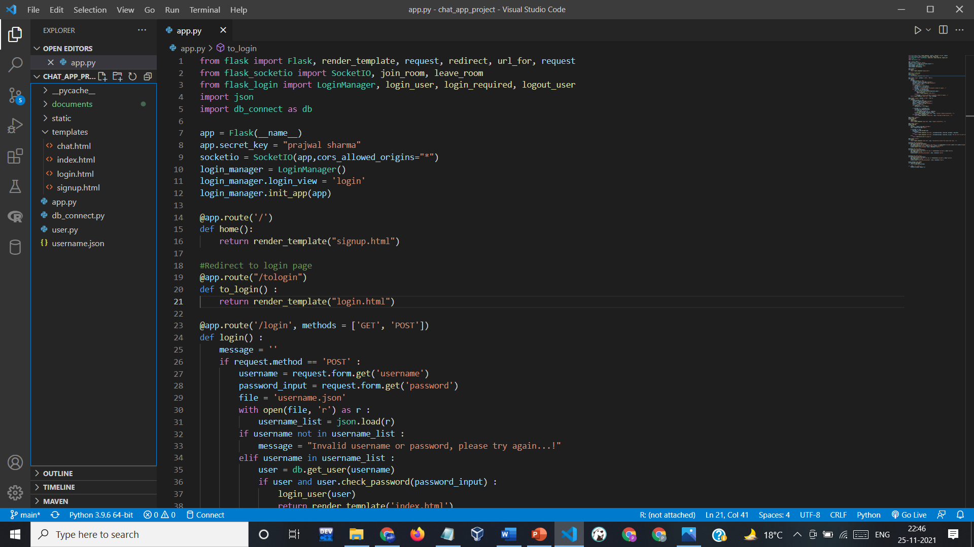
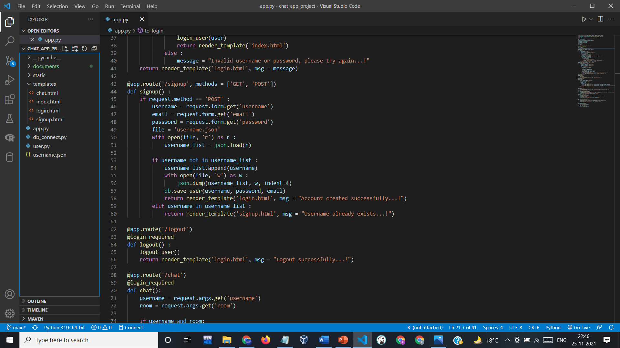
5. PYTHON CODE :

Slide 19
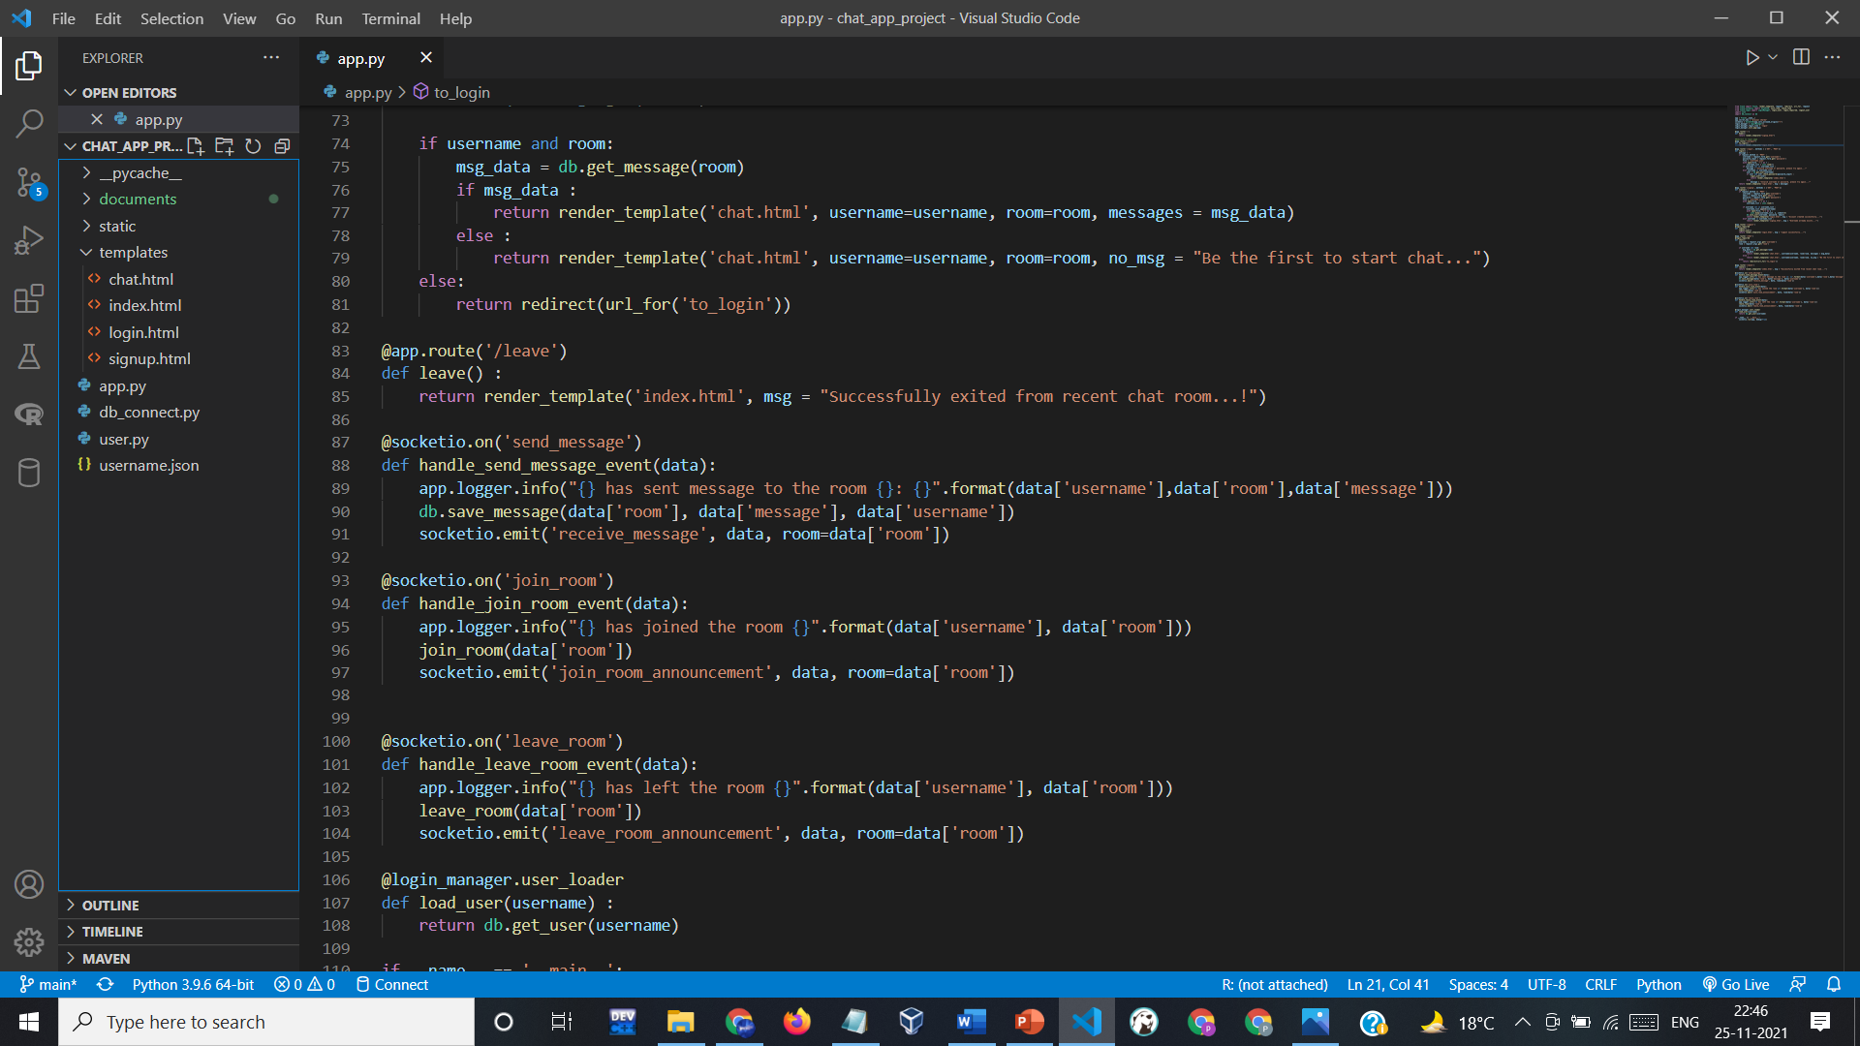
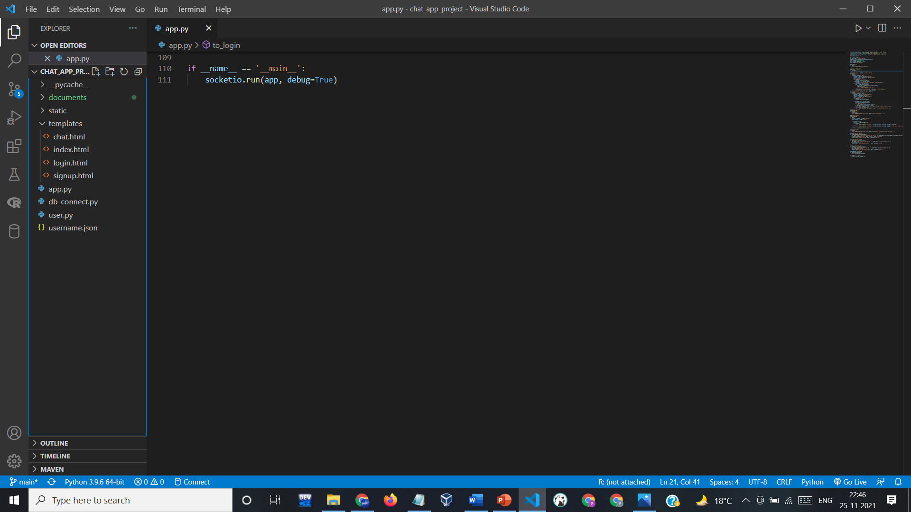
5. PYTHON CODE :

Slide 20
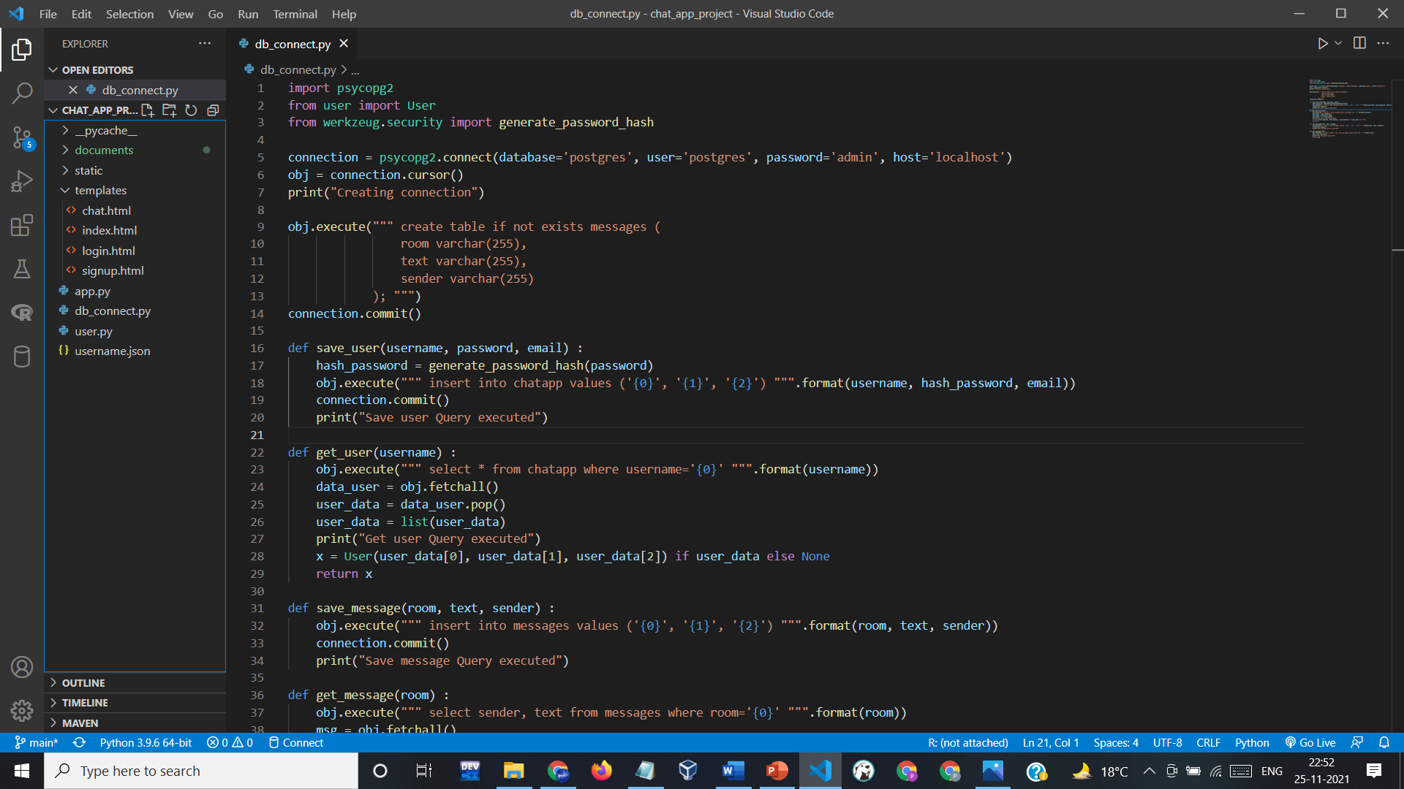
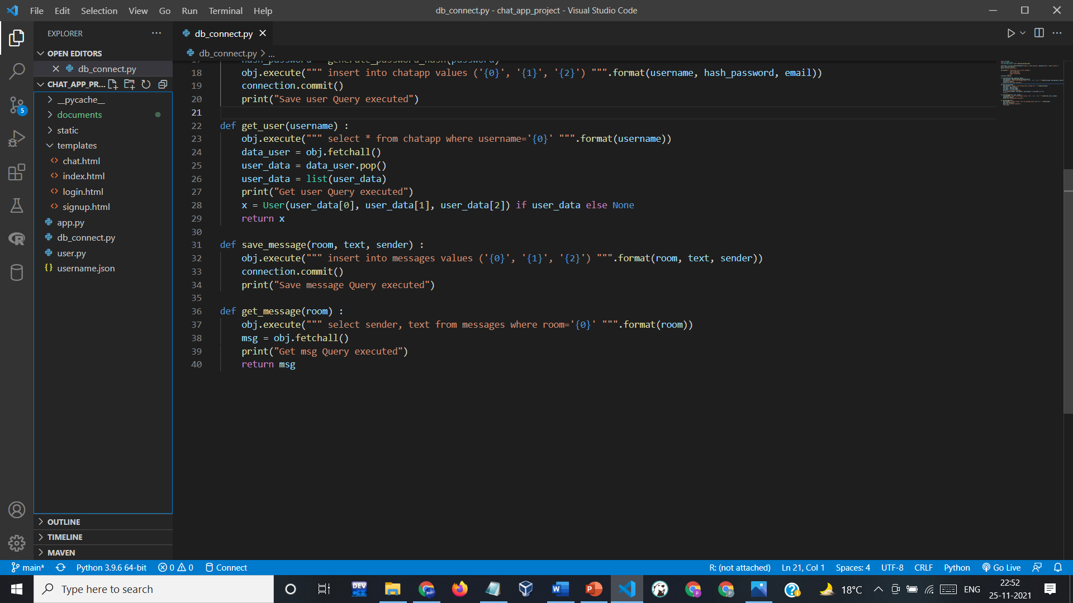
6. DATABASE PART :

Slide 21
WORKING
Here’s the implementation of our project. Below is the front end page that is displayed when we first open our application.
This application connects random people with each other and they can talk without actually showing their names.

Slide 22
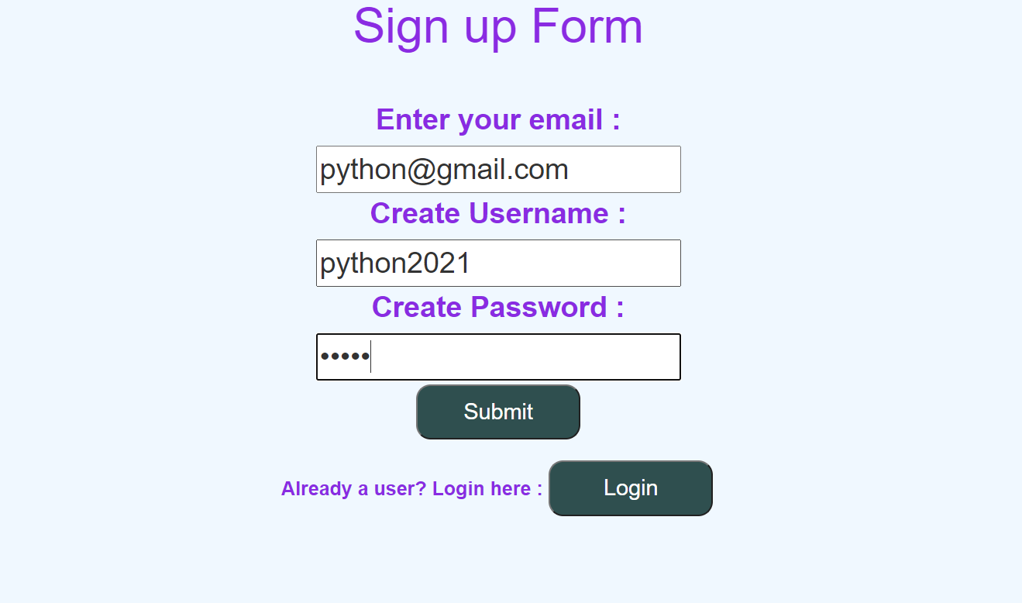
WORKING
1. Firstly, we have to register ourself by simply entering email id and creating username and password.
Here you can see that if we are already a user, we can simply go to login page from here also.

Slide 23
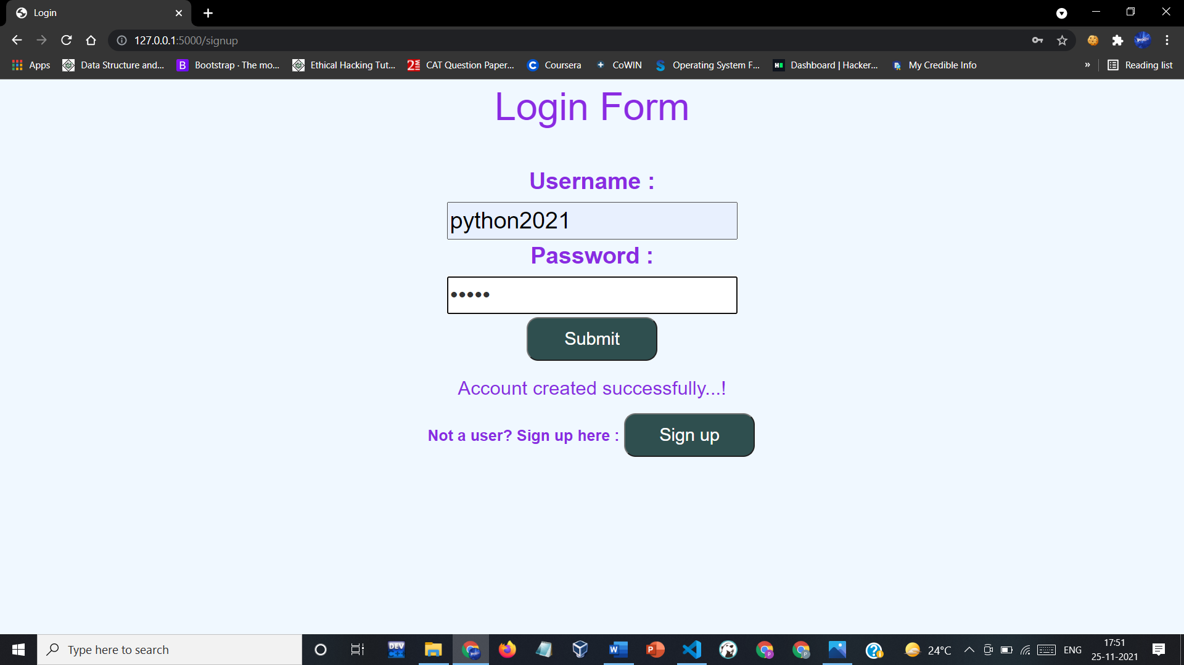
WORKING
2. Once we have registered, now we have to login to the registered account.
Here you can see the message of account creation, which comes just after registration. And also, we can redirect to signup page again directly from here.

Slide 24
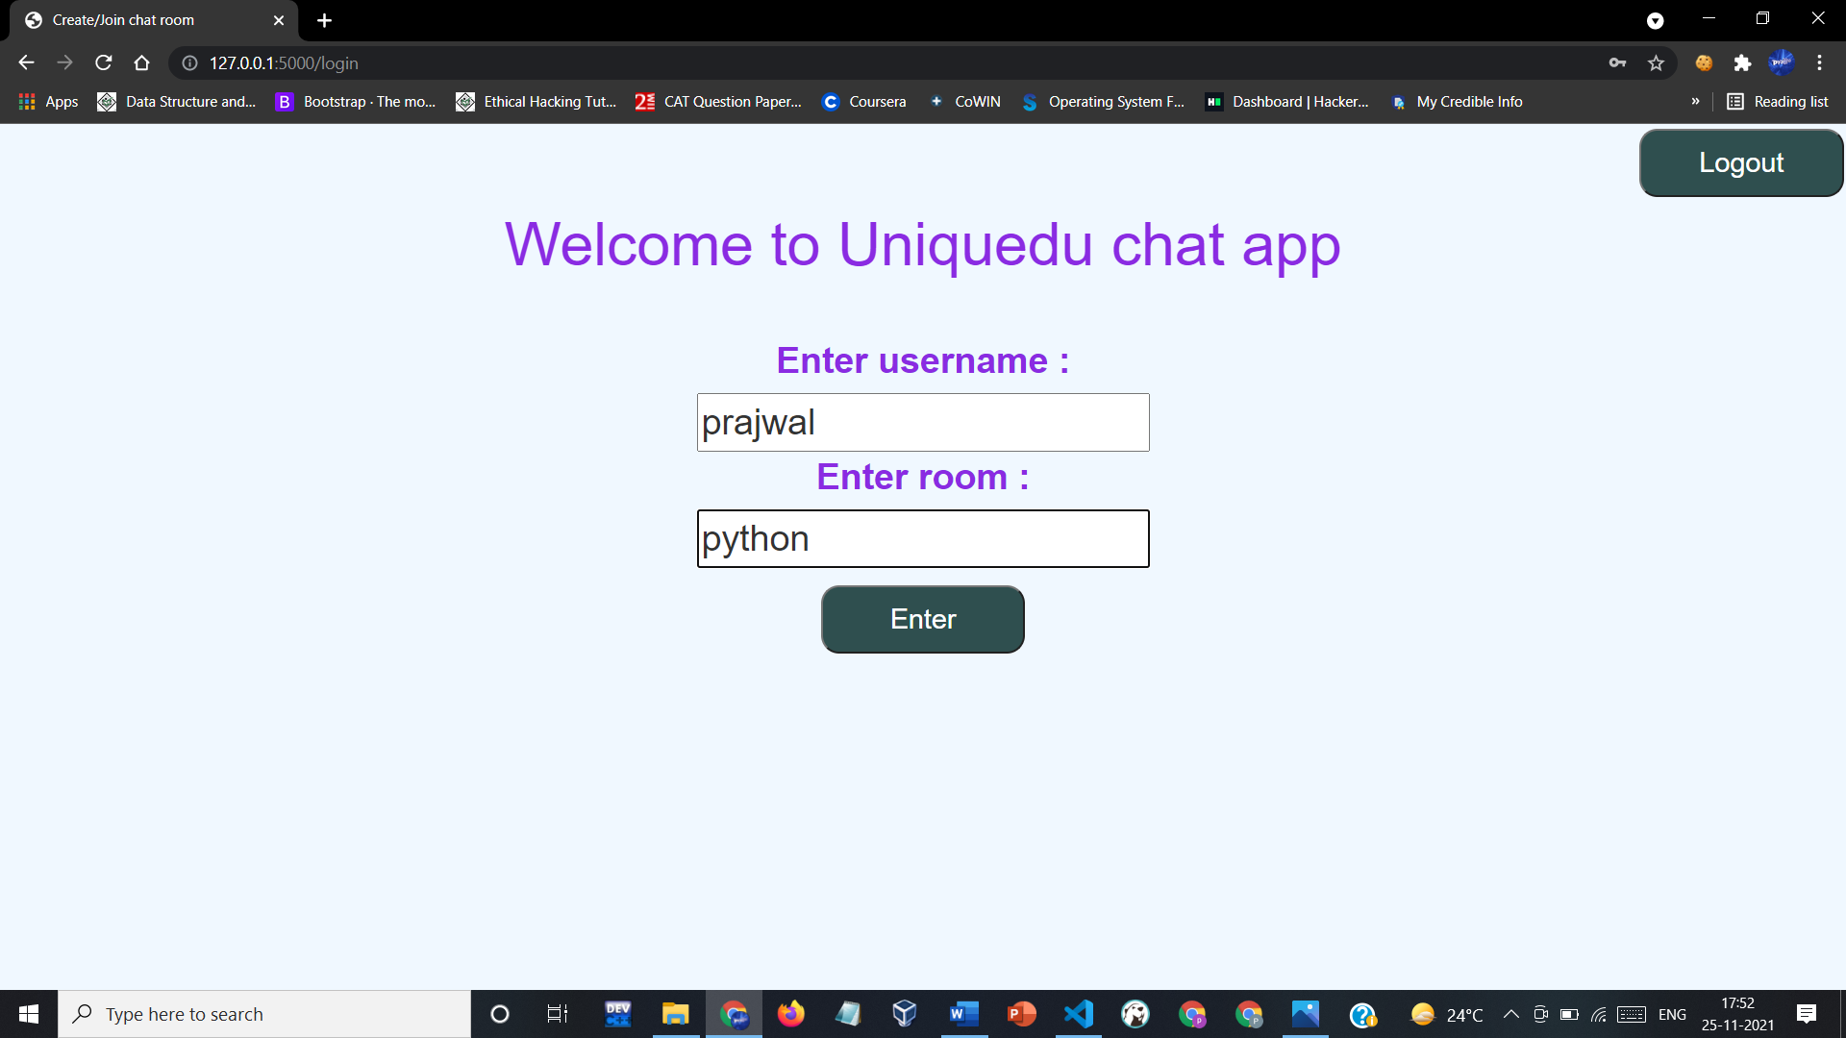
WORKING
3. Now we have login successfully and now we can create or join any room with any name as our wish.
As you can see that we can easily logout from here by clicking the logout button.

Slide 25
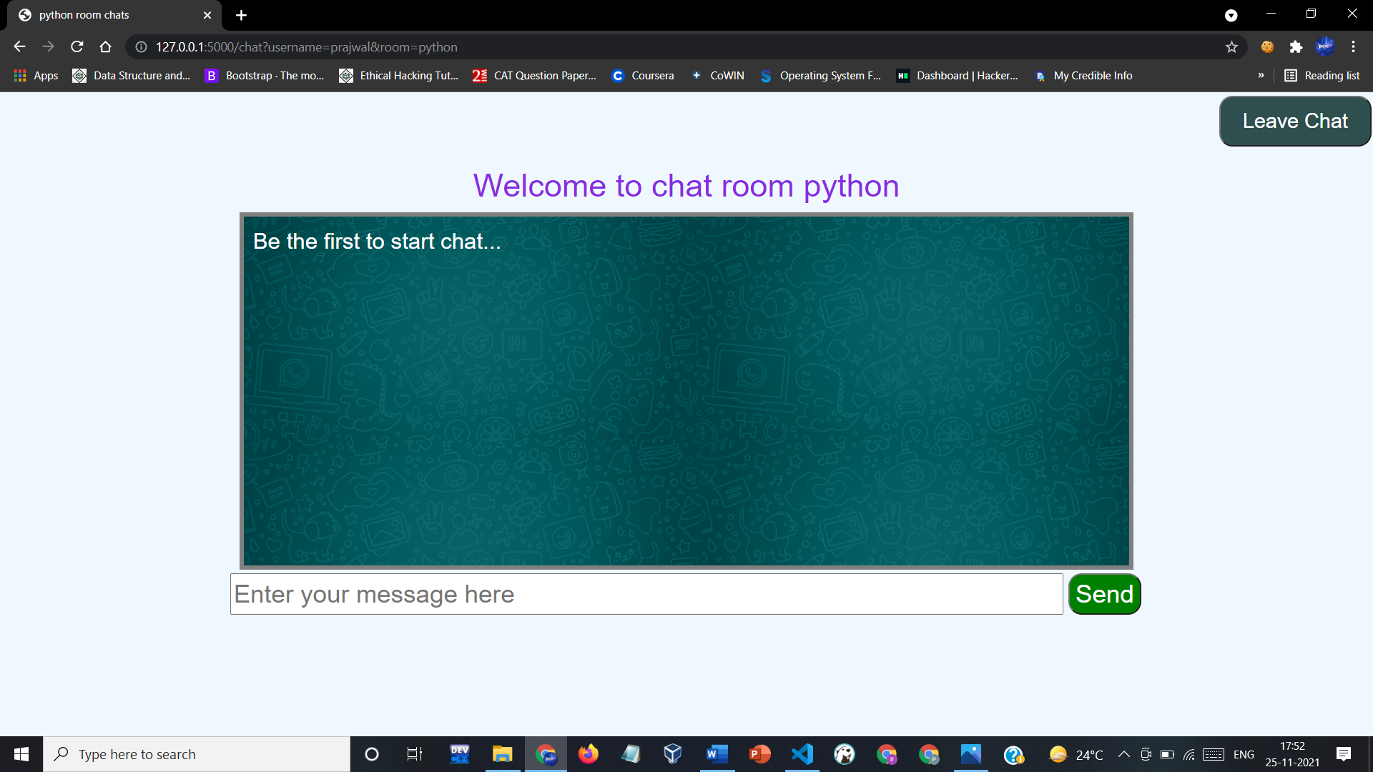
WORKING
4. After entering the room, we can chat with random people as many as we can.
Now I will create a new account and join the same and then we can see that both can chat with each other.

Slide 26
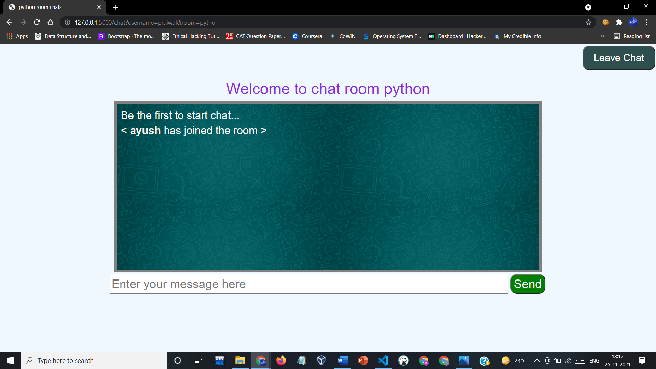
WORKING
I have joined the same room named python with username Ayush and we can see that there is a message of joining of Ayush in the chat window of Prajwal.
Now they both can talk to each other.

Slide 27
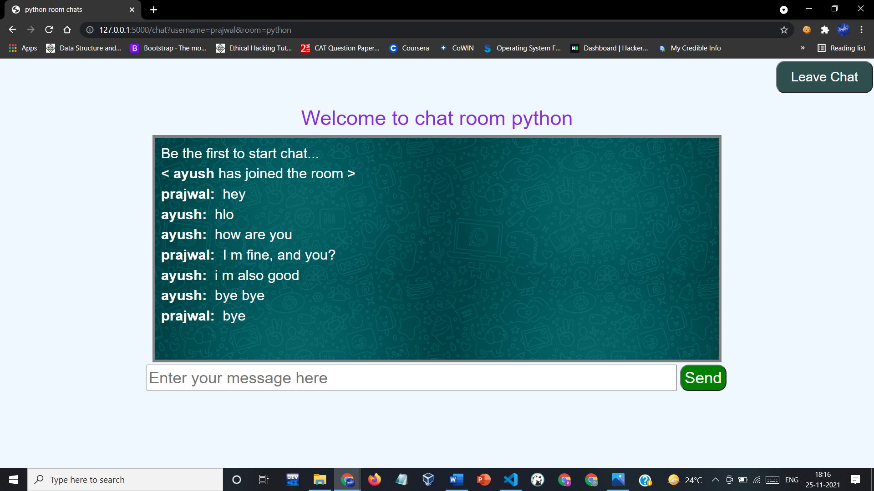
WORKING
Chat window of Prajwal :

Slide 28

WORKING
Chat window of Ayush :
Prajwal leaves the room first so, there is a message of room leaving in the chat window of Ayush.
This was the implementation of my project. Now, I want to show some more things that my application does.

Slide 29
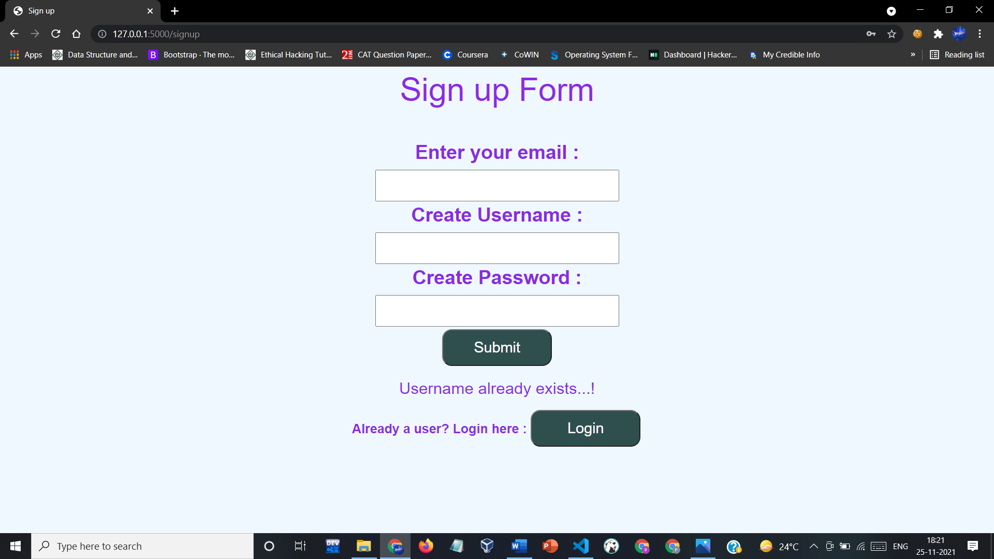
WORKING
1. Checking of user existence.
If user already exists than this application does not allows to again create the account with same name.

Slide 30
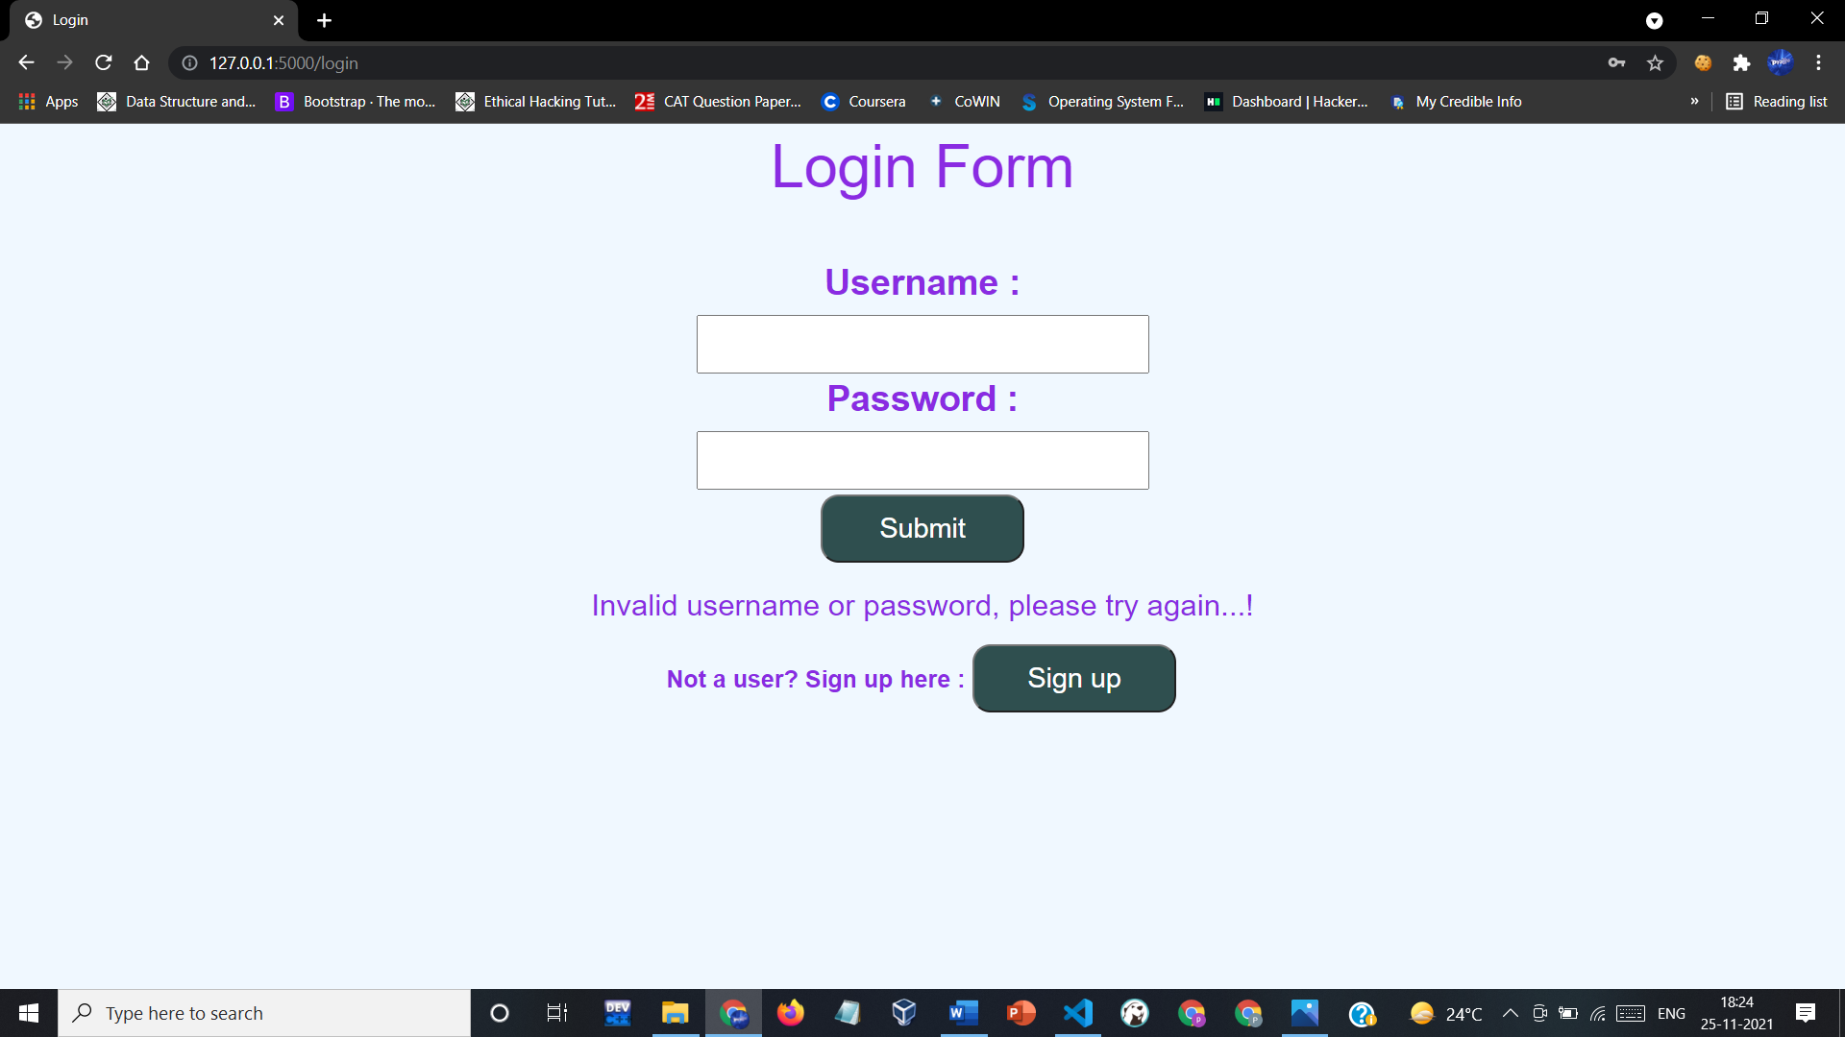
WORKING
2. Checking of username and password during login.
If username is not present or password is wrong than above displayed message is shown.

Slide 31

WHAT WE LEARNED
What all new technologies we learned:-
Python
Flask
HTML & CSS
Web Sockets
Basic SQL queries
More important things that we learned:-
Time Management
Working under deadlines
Setting and achieving goals in project building.
Debugging the code
Utilize resources on the internet in the best possible manner.
Doing project documentation (Report, Presentations etc.).
Presentation skills for presenting our ideas clearly.

Slide 32


